Slide 1
COM1013
INTRODUCTION TO COMPUTER SCIENCE
Lecturer: Begüm MUTLU BİLGE, PhD
begummutlubilge+com1013@gmail.com (recommended)
bmbilge@ankara.edu.tr

Slide 2
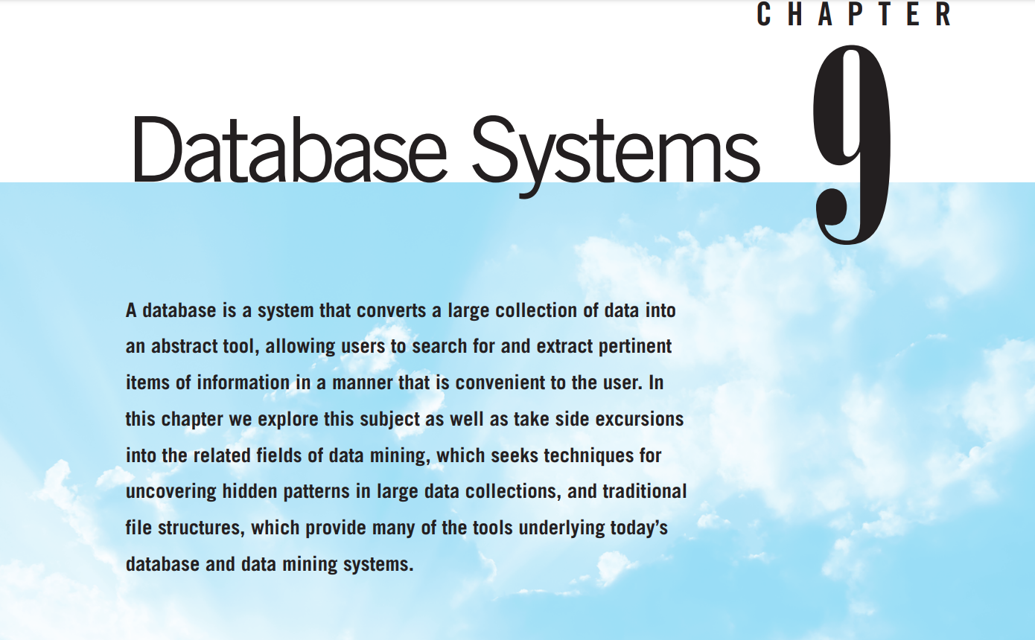

Slide 3
Database Systems
Today’s technology is capable of storing extremely large amounts of data, but such data collections are useless unless we are able to extract those particular items of information that are pertinent to the task at hand.
Notes:
Today’s technology is capable of storing extremely large amounts of data, but
such data collections are useless unless we are able to extract those particular
items of information that are pertinent to the task at hand. In this chapter we will
study database systems and learn how these systems apply abstraction to convert large data conglomerates into useful information sources. As a related topic,
we will investigate the rapidly expanding field of data mining, whose goal is to
develop techniques for identifying and exploring patterns within data collections.
We will also examine the principles of traditional file structures, which provide
the underpinnings for today’s database and data mining systems

Slide 4
Database Fundamentals
The term database refers to a collection of data that is
multidimensional in the sense that internal links between its entries make the information accessible from a variety of perspectives.
Traditional file system, flat file:
a one-dimensional storage system, meaning that it presents its information from a single point of view
Notes:
The term database refers to a collection of data that is multidimensional in the
sense that internal links between its entries make the information accessible
from a variety of perspectives.
This is in contrast to a traditional file system (Section 9.5), sometimes called a flat file, which is a one-dimensional storage system, meaning that it presents its information from a single point of view.
Whereas a flat file containing information about composers and their compositions might provide a list of compositions arranged by composer, a database might present all the works by a single composer, all the composers who wrote
a particular type of music, and perhaps the composers who wrote variations of another composer’s work.

Slide 5
The Significance of Database Systems
each application tended to be implemented as a separate system with its own collection of data.
many different but related items were stored in separate systems
Duplicated information
database systems emerged as a means of integrating the information stored and maintained by a particular organization
Notes:
Historically, as computing machinery found broader uses in information management, each application tended to be implemented as a separate system with its own collection of data. Payroll was processed using the payroll file, the personnel department maintained its own employee records, and inventory was managed via an inventory file.
This meant that much of the information required by an organization was duplicated throughout the company, while many different but
related items were stored in separate systems.
In this setting, database systems emerged as a means of integrating the information stored and maintained by a particular organization (Figure 9.1). With such a system, the same sales data could be used to produce restocking orders; create reports on market trends, direct advertisements, and product announcements to customers who are most likely to respond favorably to such information; and generate bonus checks for members of the sales force.

Slide 6
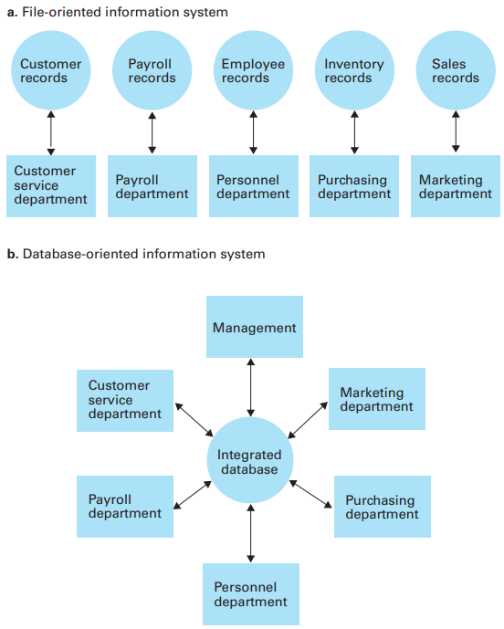
A file versus database organization
Notes:
Such integrated pools of information provided a valuable resource with which management decisions could be made, assuming the information could
be accessed in a meaningful way. In turn, database research focused on developing techniques by which the information in a database could be brought to the decision-making process. Much progress has been made in this regard. Today, database technology, combined with data mining techniques, is an important management tool, allowing the management of an organization to extract pertinent information from enormous amounts of data covering all aspects of the organization and its environment

Slide 7
The Significance of Database Systems
Database systems have become the underlying technology that supports many of the more popular sites on the World Wide Web
Google, eBay, and Amazon provide an interface between clients and databases.
To respond to a client’s request,
  the server interrogates a database,
  organizes the results in the form of a Web page, and
  sends that page to the client.
Notes:
Moreover, database systems have become the underlying technology that supports many of the more popular sites on the World Wide Web. The underlying theme of sites such as Google, eBay, and Amazon is to provide an interface between clients and databases. To respond to a client’s request, the server interrogates a database, organizes the results in the form of a Web page, and sends that page to the client. Such Web interfaces have popularized a new role for database technology in which a database is no longer a means of storing a company’s records but, instead, is the company’s product. Indeed, by combining database technology with Web interfaces, the Internet has become a major worldwide information source.

Slide 8
The Role of Schemas
Danger: the potential of sensitive data being accessed by unauthorized personnel.
Someone placing an order at a company’s website should not have access to the company’s financial data;
An employee in a company’s benefits department may need access to the company’s employee records but should not have access to the corporation’s inventory or sales records.
Thus the ability to control access to the information in the database is as important as the ability to share it.

Slide 9
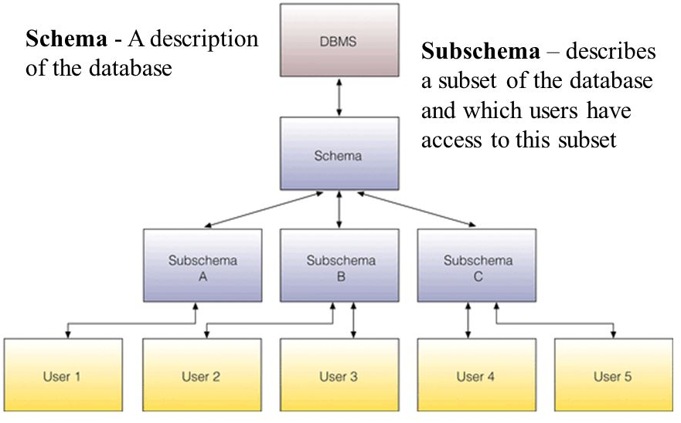
The Role of Schemas
To provide different users access to different information within a database, database systems often rely on schemas and subschemas.
Notes:
To provide different users access to different information within a database, database systems often rely on schemas and subschemas.
A schema is a description of the entire database structure that is used by the database software to maintain the database.
A subschema is a description of only that portion of the database pertinent to a particular user’s needs.
A subschema provides a view of the database as seen by an application program

Slide 10
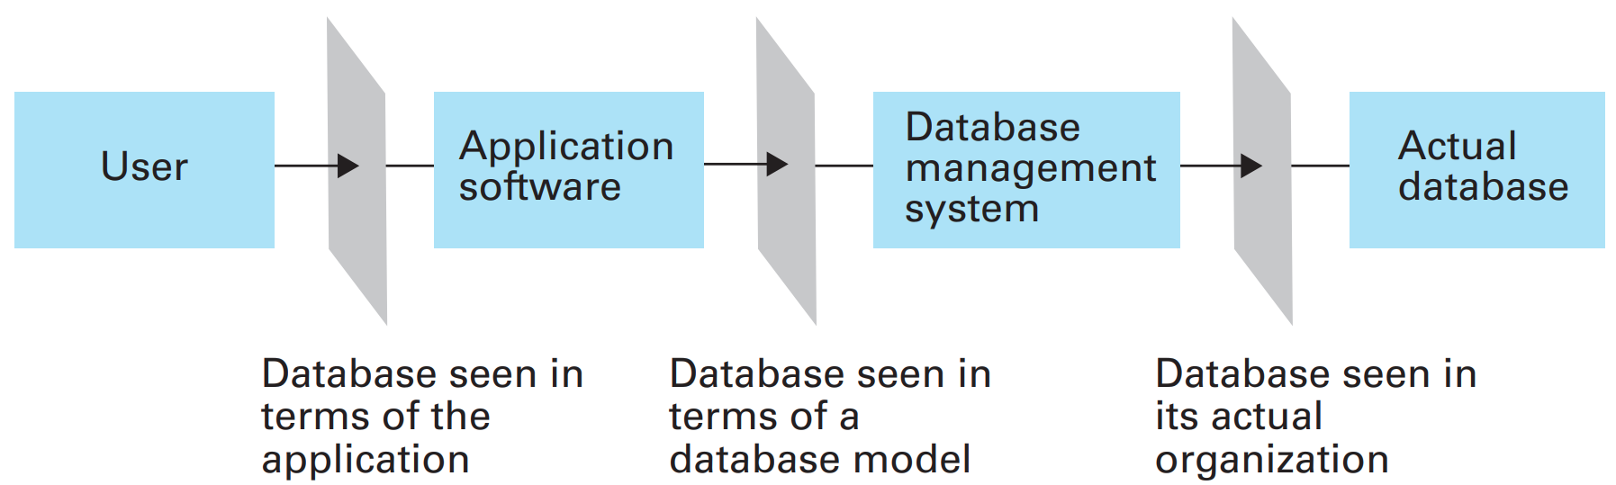
Database Management Systems
The conceptual layers of a database implementation
Notes:
A typical database application involves multiple software layers, which we will group into two major layers—an application layer and a database management layer.
The application software handles the communication with the user of the database and may be quite complex, as exemplified by applications in which users access a database by means of a website. In that case the entire application layer consists of clients throughout the Internet and a server that uses the database to fill the requests from the clients.
Note that the application software does not directly manipulate the database. The actual manipulation of the database is accomplished by the database management system (DBMS). Once the application software has determined what action the user is requesting, it uses the DBMS as an abstract tool to obtain the results. If the request is to add or delete data, it is the DBMS that actually alters the database. If the request is to retrieve information, it is the DBMS that performs the required searches

Slide 11
Database Models
This conceptual view of the database is called a database model.
the relational database model
the object-oriented database model

Slide 12
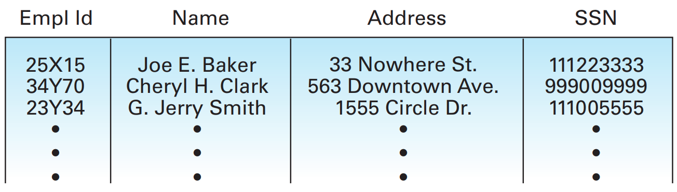
The Relational Model
We want to include information about the jobs held by the employees. HOW?
What to add: job title (secretary, office manager, floor supervisor), a job identification code (unique to each job), the skill code associated with each job, the department, and the period during which the employee held the job.
Notes:
we want to include information about the jobs held by the employees.
We might want to include a job history associated with each employee that consists of such attributes as job title (secretary, office manager, floor supervisor), a job identification code (unique to each job), the skill code associated with each job, the department in which the job exists, and the period during which the employee held the job in terms of a starting date and termination date.
(We use an asterisk as the termination date if the job represents the employee’s current position.)

Slide 13
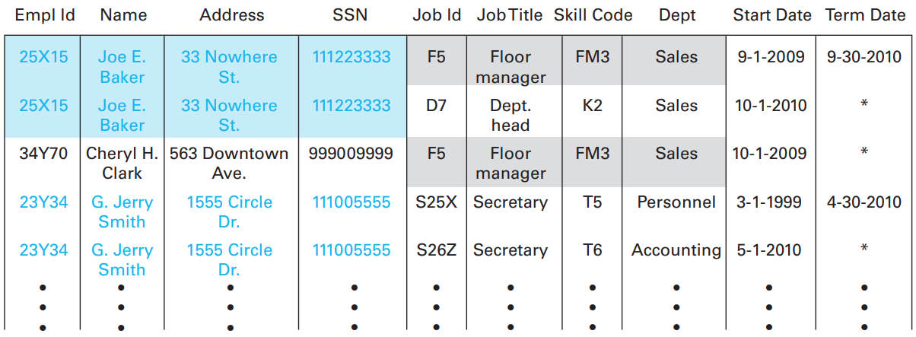
The Relational Model
What is your opinion about this design ?
The cause of all problems is that we have combined more than one concept in a single relation.
Notes:
One approach to this problem is to extend the relation (in prev figure) to include these attributes as additional columns in the table, as shown in this figure.
several problems. One is a lack of efficiency due to redundancy. The relation no longer contains one tuple for each employee but rather one tuple for each assignment of an employee to a job. If an employee has advanced in the company through a sequence of several jobs, several tuples in the new relation must contain the same information about the employee (name, address, identification number, and Social Security number). For example, the personal information about Baker and Smith is repeated because they have held more than one job. Moreover, when a particular position has been held by numerous employees, the department associated with that job along with the appropriate skill code must be repeated in each tuple representing an assignment of the job. For example, the description of the floor manager job is duplicated because more than one employee has held this position. Another, perhaps more serious, problem with our extended relation surfaces when we consider deleting information from the database. Suppose for example that Joe E. Baker is the only employee to hold the job identified as D7. If he were to leave the company and be deleted from the database represented in Figure 9.4, we would lose the information about job D7. After all, the only tuple containing the fact that job D7 requires a skill level of K2 is the tuple relating to Joe Baker. You might argue that the ability to erase only a portion of a tuple could solve the problem, but this would in turn introduce other complications. For instance, should the information relating to job F5 also be retained in a partial tuple, or does this information reside elsewhere in the relation? Moreover, the temptation to use partial tuples is a strong indication that the design of the database can be improved. The cause of all these problems is that we have combined more than one concept in a single relation.
As proposed, the extended relation in Figure 9.4 contains information dealing directly with employees (name, identification number, address, Social Security number), information about the jobs available in the company (job identification, job title, department, skill code), and information regarding the relationship between employees and jobs (start date, termination date).

Slide 14
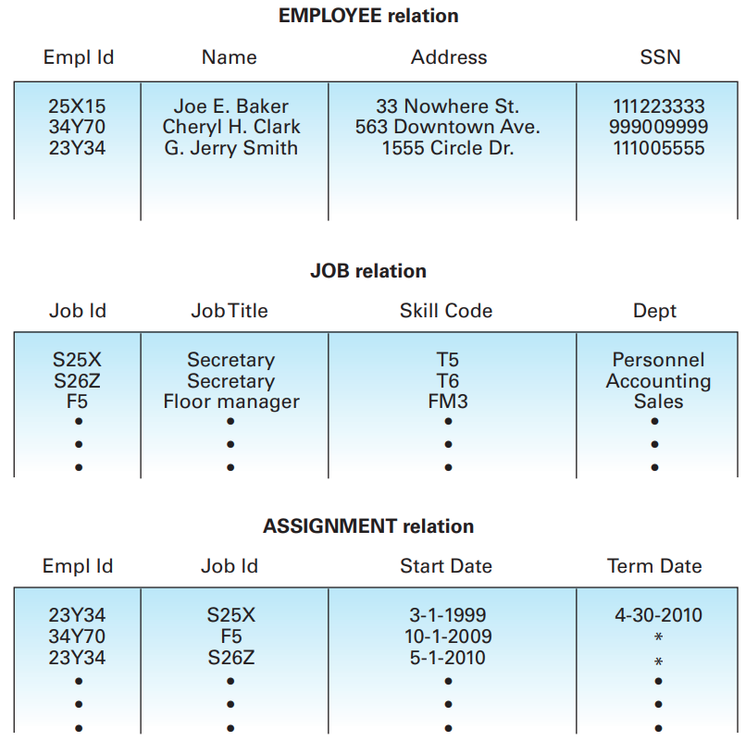
The Relational Model
Notes:
On the basis of this observation, we can solve our problems by redesigning the system using three relations—one for each of the preceding categories. We can keep the original relation in Figure 9.3 (which we now call the EMPLOYEE relation) and insert the additional information in the form of the two new relations called JOB and ASSIGNMENT, which produces the database in Figure 9.5.

Slide 15
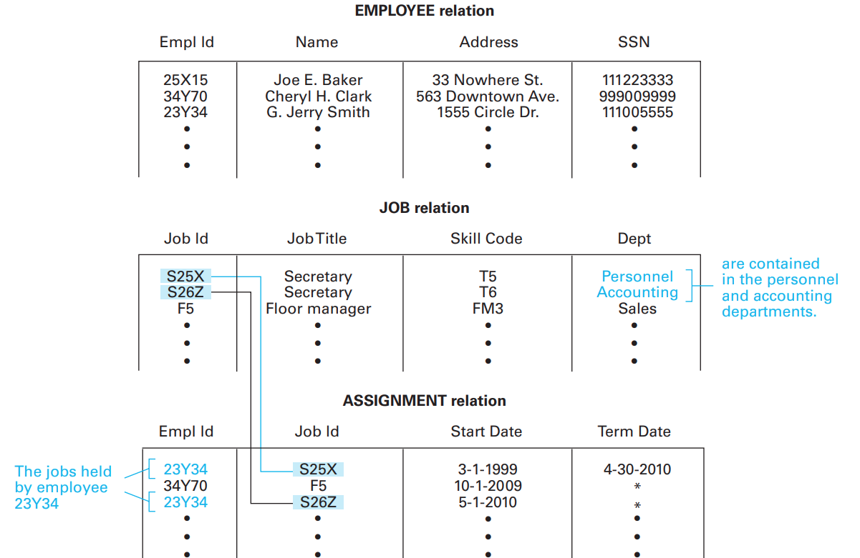
The Relational Model
Finding the departments in which employee 23Y34 has worked
Notes:
A database consisting of these three relations contains the pertinent information about employees in the EMPLOYEE relation, about available jobs in the JOB relation, and about job history in the ASSIGNMENT relation. Additional information is implicitly available by combining the information from different relations. For instance, if we know an employee’s identification number, we can
find the departments in which that employee has worked by first finding all the
jobs that employee has held using the ASSIGNMENT relation and then finding the
departments associated with those jobs by means of the JOB relation (Figure 9.6).
Through processes such as these, any information that could be obtained from
the single large relation can be obtained from the three smaller relations without
the problems previously cited.

Slide 16
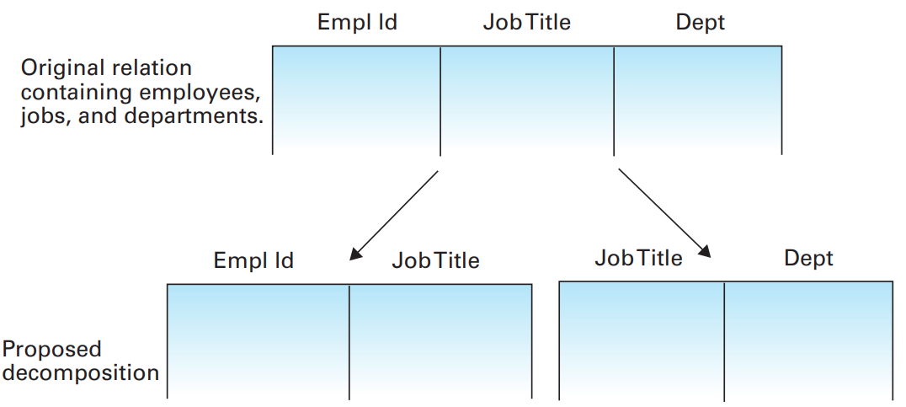
The Relational Model
Dividing information into various relations is not always as trouble-free.
Notes:
Unfortunately, dividing information into various relations is not always as trouble-free as in the preceding example.
For instance, compare the original relation in Figure 9.7, with attributes EmplId, JobTitle, and Dept, to the proposed decomposition into two relations.
At first glance, the two-relation system might appear to contain the same information as the single-relation system, but, in fact, it does not.
Consider for example the problem of finding the department in which a given employee works.
This is easily done in the single-relation system by interrogating the tuple containing the employee identification number of the target employee and extracting the corresponding department. However, in the two-relation system, the desired information is not necessarily available. We can find the job title of the target employee and a department having such a job but this does not necessarily mean that the target employee works in that particular department, because several departments might have jobs with the same title.

Slide 17
The Relational Model
Sometimes dividing a relation into smaller relations causes the loss of information, and sometimes it does not.
Lossless (nonloss) decomposition
  Such relational characteristics are important design considerations.
The goal is
  To identify the relational characteristics that can lead to problems in database design and
  To find ways to reorganize those relations to remove these problematic characteristics.
Notes:
We see, then, that sometimes dividing a relation into smaller relations causes the loss of information, and sometimes it does not. (The latter is called a lossless decomposition—or sometimes a nonloss decomposition.)
Such relational characteristics are important design considerations.
The goal is to identify the relational characteristics that can lead to problems in database design and find ways to reorganize those relations to remove these problematic characteristics.

Slide 18
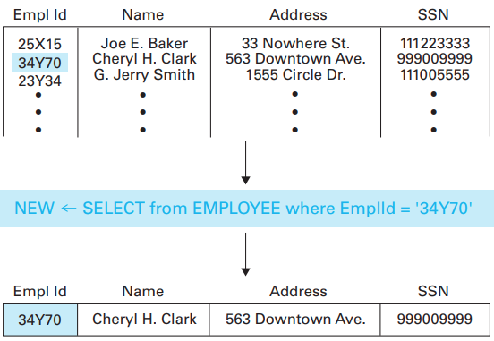
Relational Operations
SELECT: One operation we might want to perform on a relation is to select tuples possessing certain characteristics and to place these selected tuples in a new relation.
EMPLOYEE relation
NEW relation

Slide 19
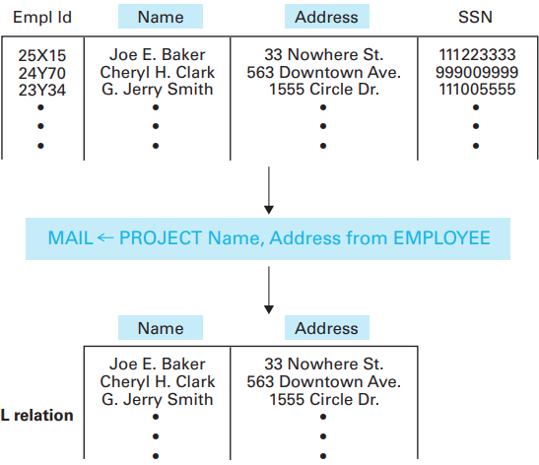
Relational Operations
PROJECT: In contrast to the SELECT operation, which extracts rows from a relation, the PROJECT operation extracts columns
EMPLOYEE relation
NEW relation

Slide 20
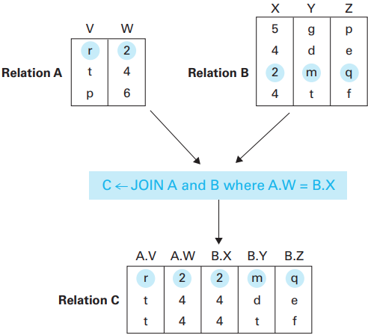
Relational Operations
JOIN: It is used to combine different relations into one relation.

Slide 21
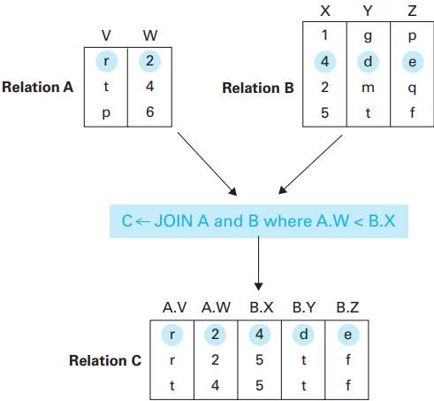
Relational Operations
JOIN: The JOIN of two relations produces a new relation whose attributes consist of the attributes from the original relations.

Slide 22
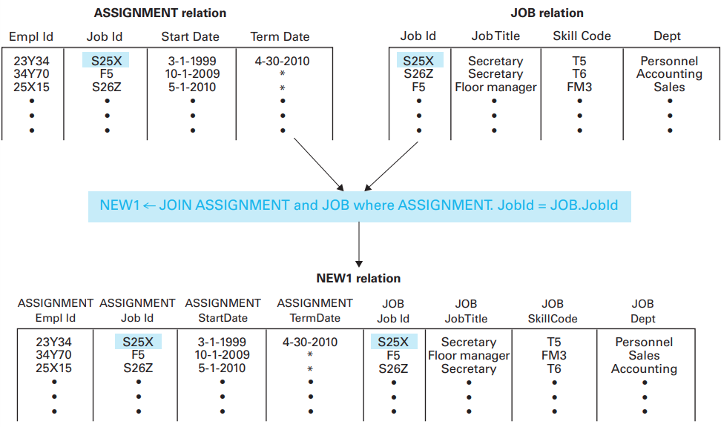
Relational Operations
JOIN

Slide 23

SQL
produces a listing of all employee names and addresses contained in the relation Employee. Note that this is merely a PROJECT operation.

Slide 24
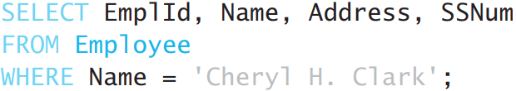
SQL
produces all the information from the tuple associated with Cheryl H. Clark in the Employee relation. This is essentially a SELECT operation.

Slide 25
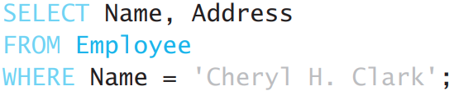
SQL
produces the name and address of Cheryl H. Clark as contained in the Employee relation. This is a combination of SELECT and PROJECT operations.

Slide 26
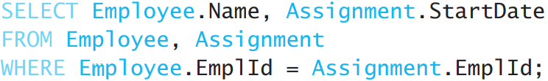
SQL
produces a listing of all employee names and their dates of initial employment.
Note that this is the result of JOINing the relations Employee and Assignment and then SELECTing and PROJECTing the appropriate tuples and attributes as identified in the where and select clauses

Slide 27
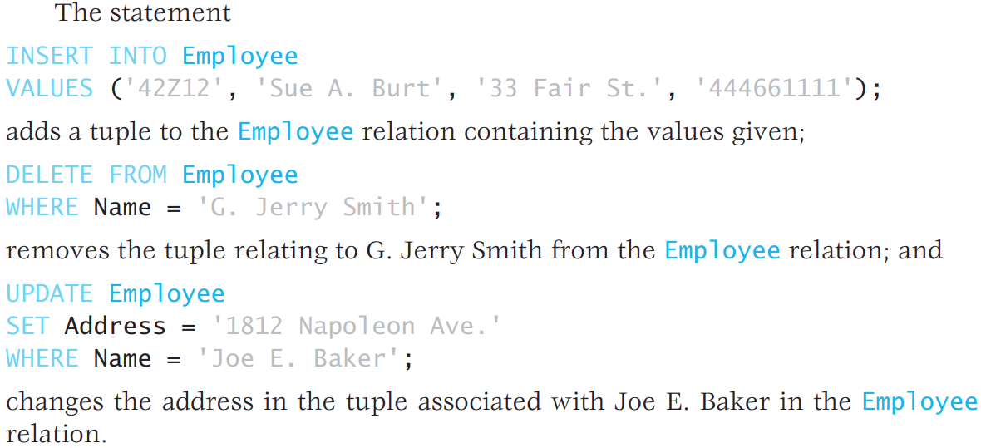
SQL
SQL encompasses statements for defining the structure of relations, creating relations, and modifying the contents of relations as well as performing queries.

Slide 28
Traditional File Structures
Sequential Files
Audio files, video files, files containing programs, and files containing textual documents
Indexed Files
Hash Files

Slide 29
Sequential File
A file that is accessed in a serial manner from its beginning to its end as though the information in the file were arranged in one long row.
In fact, most of the files created by a typical personal computer user are sequential files.
For instance, when a spreadsheet is saved, its information is encoded and stored as a sequential file from which the spreadsheet application software can reconstruct the spreadsheet.

Slide 30
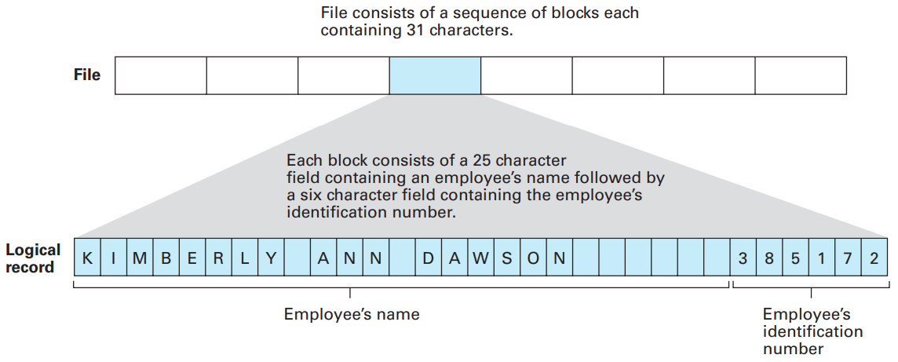
Sequential File
Notes:
For example, one could construct a simple employee file by agreeing to enter each employee
record as a string of 31 characters, consisting of a field of 25 characters containing the employee’s name (filled with enough blanks to complete the 25-character
field), followed by a field of 6 characters representing the employee’s identification
number. The final file would be a long string of encoded characters in which each
31-character block represents the information about a single employee (Figure 9.14).
Information would be retrieved from the file in terms of logical records consisting of
31-character blocks. Within each of these blocks, individual fields would be identified according to the uniform format with which the blocks were constructed.

Slide 31
Indexed Files
Sequential files are ideal for storing data that will be processed in the order in which the file’s entries are stored.
However, such files are inefficient when records within the file must be retrieved in an unpredictable order.
In such situations what is needed is a way to identify the location of the desired logical record quickly.

Slide 32
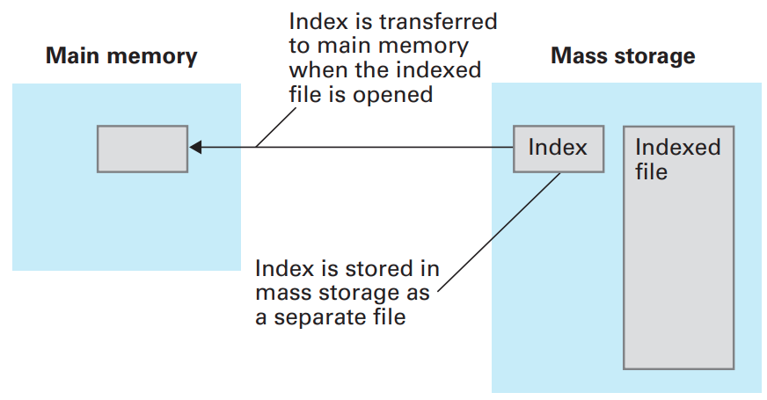
Indexed Files
A popular solution is to use an index for the file.
Such a file system is called an indexed file.
Notes:
A file’s index is normally stored as a separate file on the same mass storage device as the indexed file. The index is usually transferred to main memory before file processing begins so that it is easily accessible when access to records in the file is required (Figure 9.17). A classic example of an indexed file occurs in the context of maintaining employee records. Here an index can be used to avoid lengthy searches when you are retrieving an individual record. In particular, if the file of employee records is indexed by employee identification numbers, then an employee’s record can be retrieved quickly when the employee’s identification number is known. Another example is found on audio CDs where an index is used to allow relatively quick access to individual recordings. Over the years numerous variations of the basic index concept have been used. One variation constructs an index in a hierarchical manner so that the index takes on a layered or tree structure. A prominent example is the hierarchical directory system used by most operating systems for organizing file storage. In such a case, the directories, or folders, play the role of indexes, each containing links to its subindexes. From this perspective, the entire file system is merely one large indexed file

Slide 33
Hash Files
Issue in indexing: The expense of index maintenance.
A hash system can be summarized as follows:
The data storage space is divided into several sections, called buckets, each of which is capable of holding several records.
The records are dispersed among the buckets according to an algorithm (hash function) that converts key values into bucket numbers

Slide 34
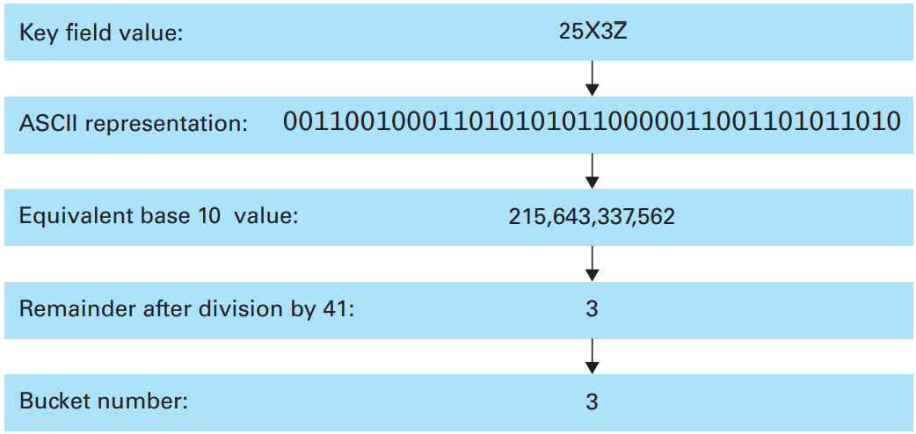
Hash Files
Hashing the key field value 25X3Z to one of 41 buckets.
Notes:
Let us apply the hashing technique to the classic employee file in which each
record contains information about a single employee in a company. First, we
establish several available areas of mass storage that will play the role of buckets.
The number of buckets and the size of each bucket are design decisions that we
will consider later. For now, let us assume that we have created 41 buckets, which
we refer to as bucket number 0, bucket number 1, through bucket number 40. (The
reason we selected 41 buckets rather than an even 40 will be explained shortly.)
Let us assume that an employee’s identification number will be used as the
key for identifying the employee’s record. Our next task, then, is to develop
a hash function for converting these keys into bucket numbers. Although the
employee identification “numbers” might have the form 25X3Z or J2X35 and are
therefore not numeric, they are stored as bit patterns, and we can interpret the
bit patterns as numbers. Using this numeric interpretation, we can divide any
key by the number of buckets available and record the remainder, which in our
case will be an integer in the range from 0 to 40. Thus we can use the remainder
of this division process to identify one of the 41 buckets (Figure 9.18).

Slide 35
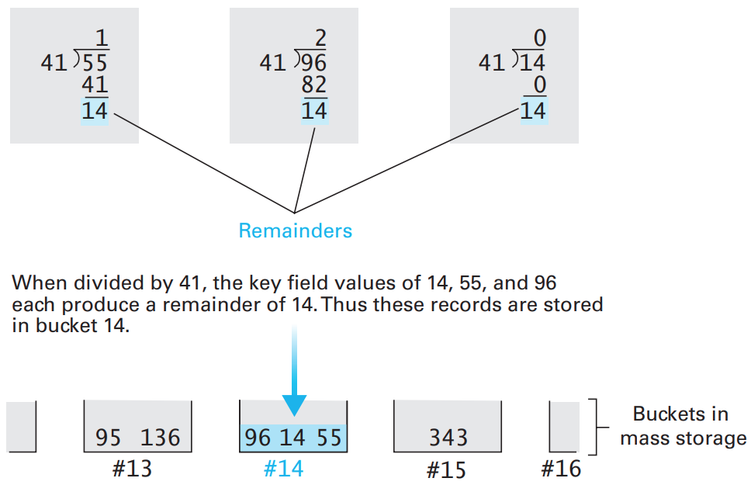
Hash Files
The rudiments of a hashing system
Notes:
Using this as our hash function, we proceed to construct the file by considering each record individually, applying our divide-by-41 hash function to its key to obtain a bucket number, and then storing the record in that bucket (Figure 9.19).
Later, if we need to retrieve a record, we need merely apply our hash function to
the record’s key to identify the appropriate bucket and then search that bucket
for the record in question.

Slide 36
Research Themes
Object Oriented Databases
Database Management Systems, DBMSs
Database Security, Threats and Defense Mechanisms
SQL and NoSQL
Data Mining

Slide 37
COM1013
INTRODUCTION TO COMPUTER SCIENCE
Lecturer: Begüm MUTLU BİLGE, PhD
begummutlubilge+com1013@gmail.com (recommended)
bmbilge@ankara.edu.tr

